Slide 1
SharePoint Framework - Day 1
Jenkins NS
@jenkinsns

Slide 2












Jenkins NS
Modern Workplace Solution Architect | Consultant
17+ Years of experience
Power Platform, Microsoft Teams, and SPFx Specialist
International Speaker | Author | Trainer
SPS/M365 Bangalore Organizer
aOS Ambassador
jenkinsns@gmail.com
in/jenkinsns
@jenkinsns
http://www.jenkinsblogs.com
https://www.youtube.com/user/jenkinsns

Slide 3

Agenda
SharePoint Framework Overview
What is SharePoint Framework
Why SharePoint Framework?
Modern toolchain

Slide 4


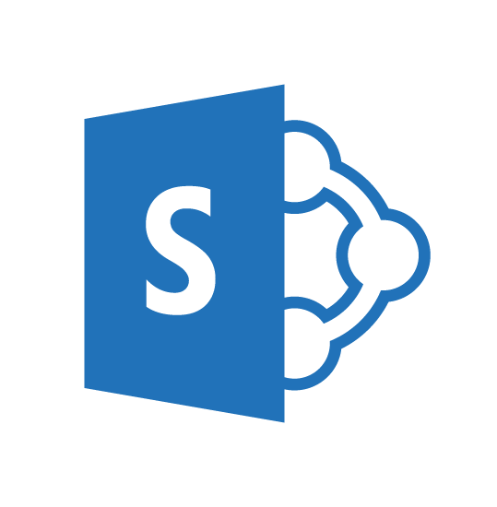
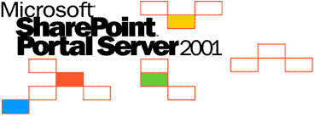
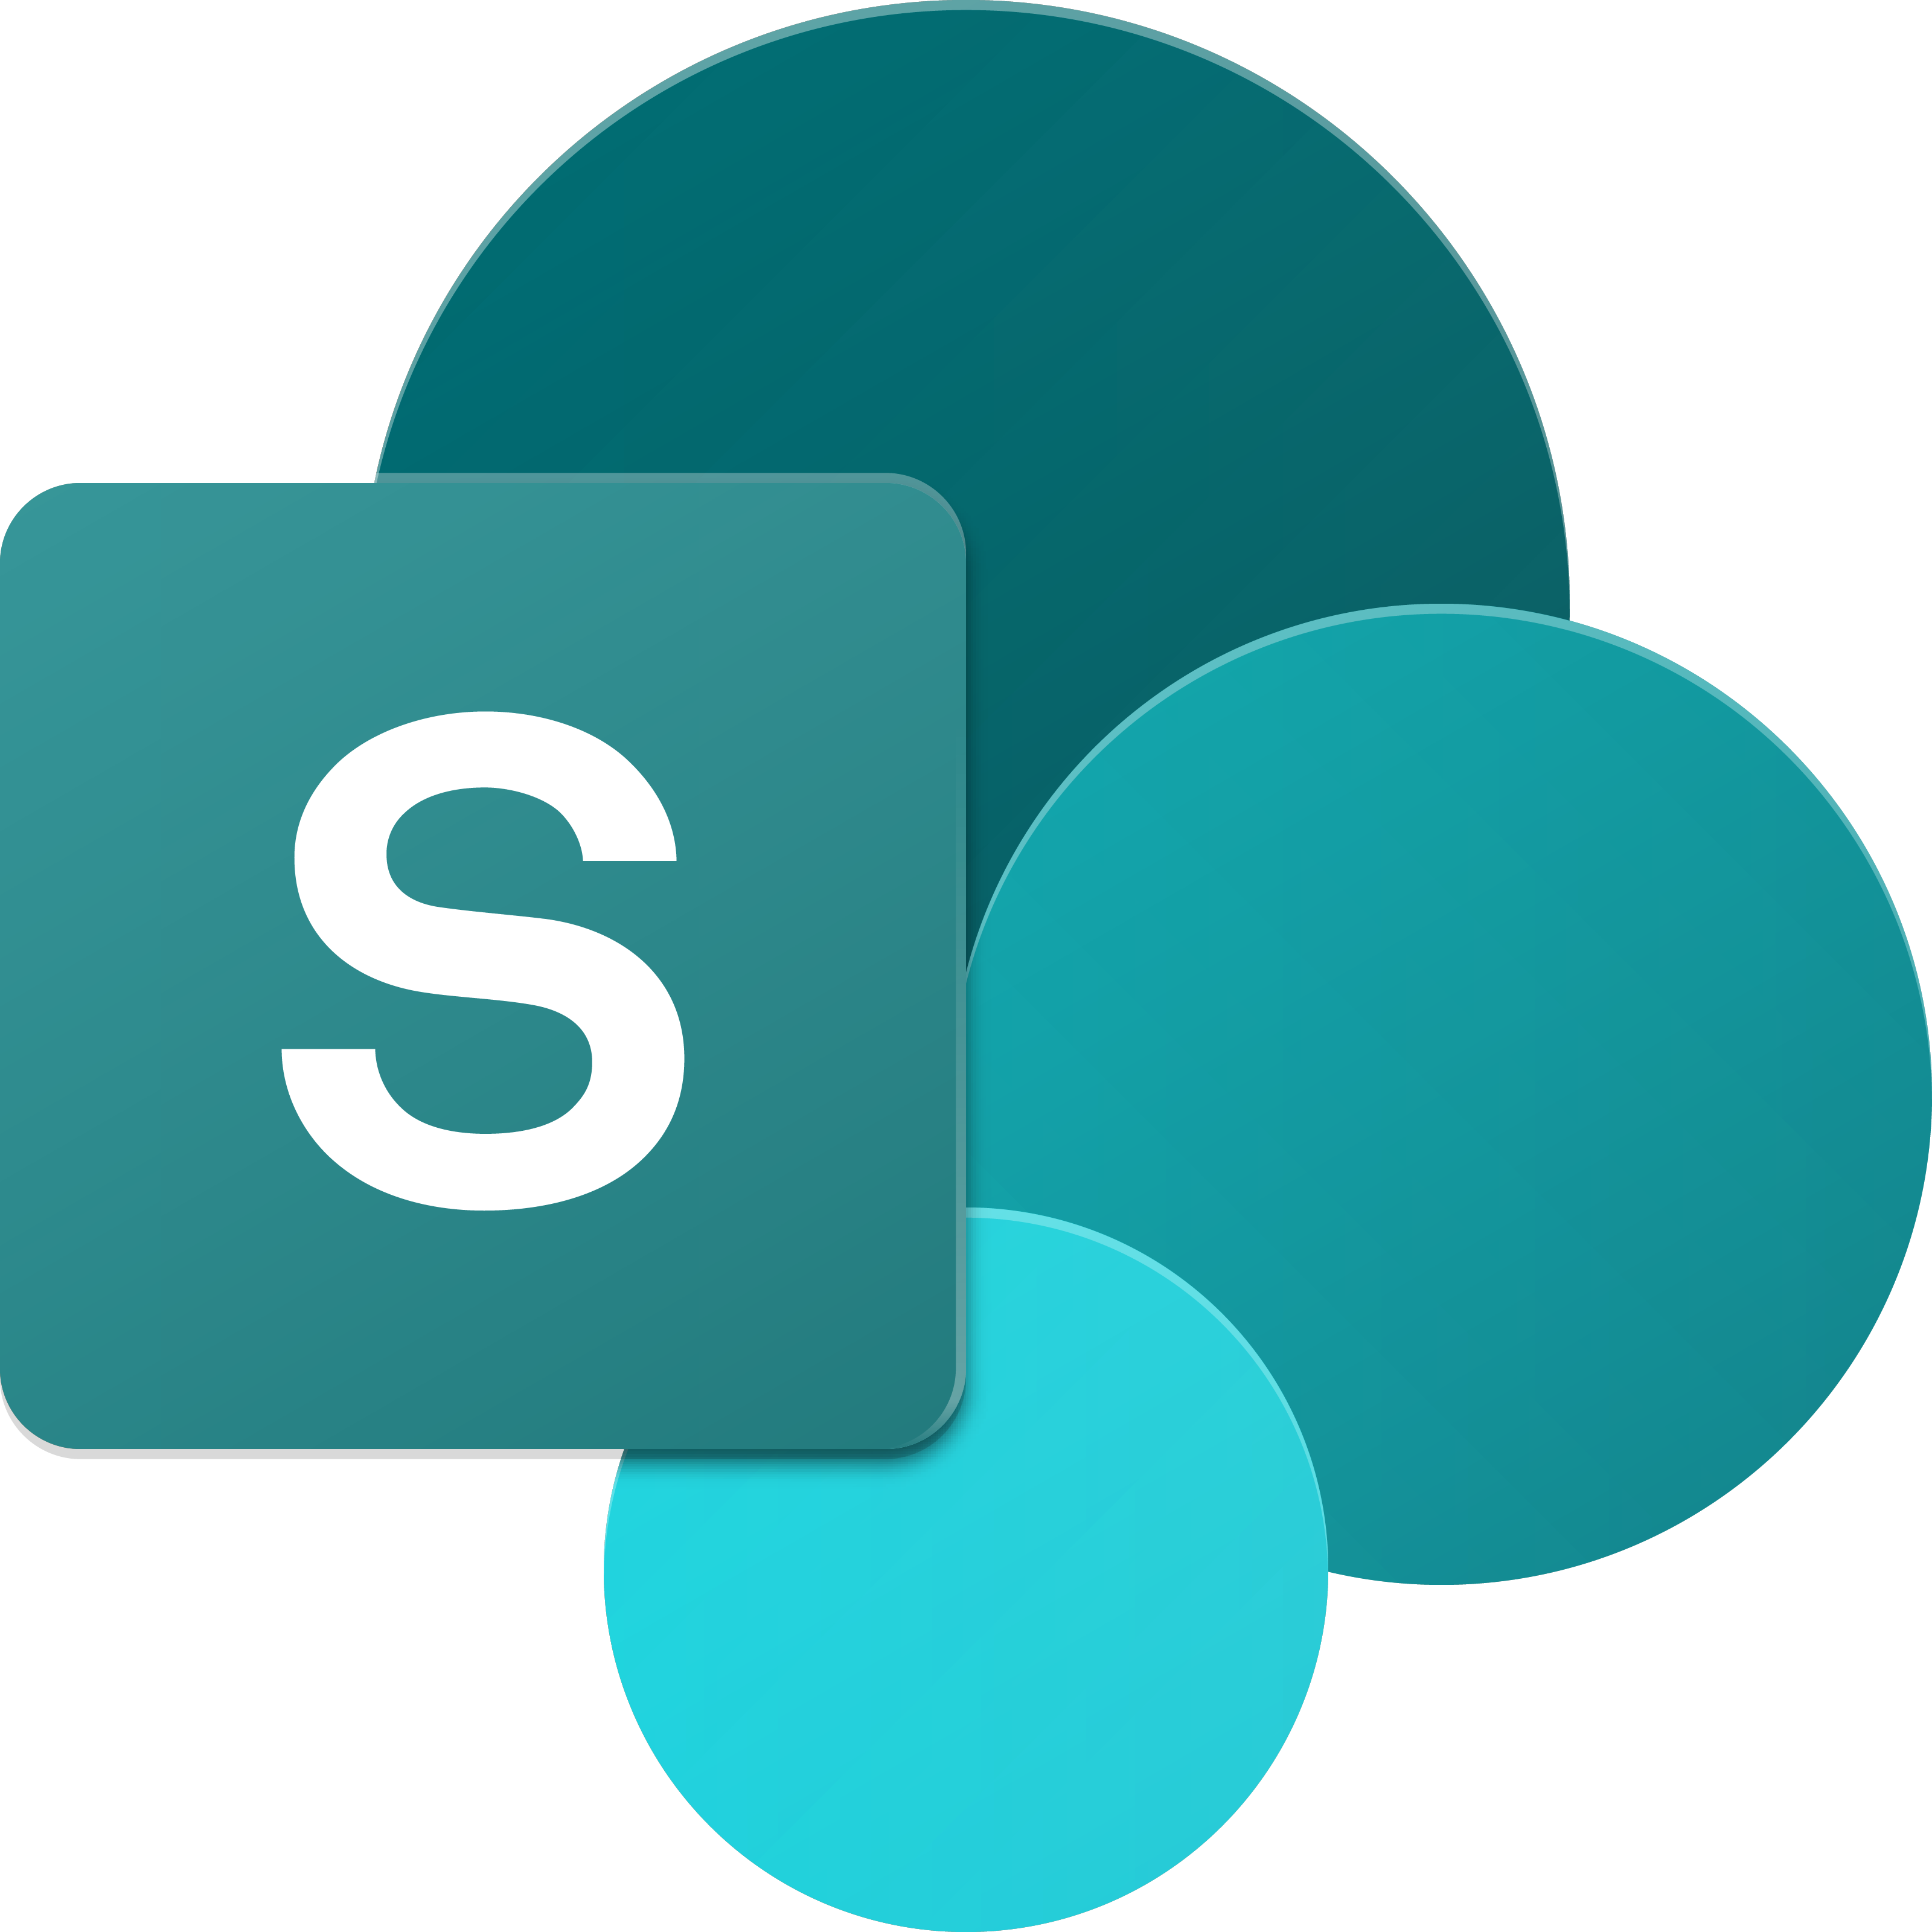
SharePoint UX – Evolving cross versions
SharePoint
Portal Server 2001
SharePoint
Portal Server 2003
Office SharePoint
Server 2007
SharePoint
Server 2010
SharePoint
Server 2013
SharePoint
Server 2016, SPO
2001
2003
2006
2009
2012
2016--19 …
ASP
Early Server Widget Tech
Single Box
ASP.NET
WebParts
CAML
SharePoint Publishing
FAST acquisition
Shared Services (e.g. taxonomy)
First Client-Side Rendering Using XSL
Search driven publishing sites
Client-Side Rendering sprinkled in, e.g. CBS, MDS, etc.
Hybrid
Modern standalone cloud apps, e.g. O365 Video, Delve, etc.
…
Aug 2016
SPFx and Office Fabric
Modern SharePoint pages
Notes:
Tahoe/SPS 2001 – ASP Based, Single Box
SP 2003 – Moved to ASP.NET, scale out, enterprise manageability
SP 2007 – Added ECM, Publishing, Shared Services
SP 2010 – FAST acquisition, search driven portals, scaled up doclibs
SP 2013 – Multitenant, base for our cloud-based release
SP 2016 – First version migrated back from Cloud

Slide 5
What is SharePoint Framework (SPFx)
The SharePoint Framework (SPFx) is a page and web part model that provides full support for client-side SharePoint development, easy integration with SharePoint data, and support for open source tooling. With the SharePoint Framework, you can use modern web technologies and tools in your preferred development environment to build productive experiences and apps that are responsive and mobile-ready from day one. The SharePoint Framework works for SharePoint Online and on-premises (SharePoint 2016 Feature Pack 2 and SharePoint 2019).
Historically, we created web parts as full trust C# assemblies that were installed on the cloud servers. However, current development models for the most part involve JavaScript running in a browser making REST API calls to the SharePoint and Office 365 back-end workloads. The SharePoint Framework is the next evolution in SharePoint development.

Slide 6
Key features of the SharePoint Framework
It runs in the context of the current user and connection in the browser. There are no iFrames for the customization (JavaScript is embedded directly to the page).
The controls are rendered in the normal page DOM.
The controls are responsive and accessible by nature.
It enables the developer to access the lifecycle in addition to render, load, serialize and deserialize, configuration changes, and more.
It is framework-agnostic. You can use any JavaScript framework that you like: React, Handlebars, Knockout, Angular, and more.
The toolchain is based on common open source client development tools such as npm, TypeScript, Yeoman, webpack, and gulp.
Performance is reliable.
End users can use SPFx client-side solutions that are approved by the tenant administrators (or their delegates) on all sites, including self-service team, group, or personal sites.
SPFx web parts can be added to both classic and modern pages.

Slide 7
SPFx Version History
SharePoint Framework is a new development model for building SharePoint customization. In the last three years, we have seen many number of releases for SharePoint Framework.
17 Feb 2017 - GA(1.0.0), 1.0.1, 1.0.2, 1.1.0, 1.1.1, 1.1.3, 1.2.0, 1.3.0, 1.3.1, 1.3.2, 1.3.4, 1.4.0, 1.4.1, 1.5.0, 1.5.1, 1.6.0, 1.7.0, 1.7.1, 1.8.0, 1.8.1, 1.8.2, 1.9.0, 1.9.1, 1.10.0, 1.11.0, 1.12.0 (Mar 17 2021)
Aug 2016 - Drop 1, Drop 2, Drop 3, Drop 4, Drop 5, Drop 6, RC0
Always Microsoft recommend to use latest version, but in reality, it is very difficult to manage with team-based development, since we always don't upgrade to a new version.
Notes:
https://docs.microsoft.com/en-us/sharepoint/dev/spfx/release-1.12.0

Slide 8
SharePoint Server Support
SharePoint 2016 Feature Pack 2 supports SharePoint Framework v1.1.0
SharePoint 2019 supports SharePoint Framework v1.4.1

Slide 9
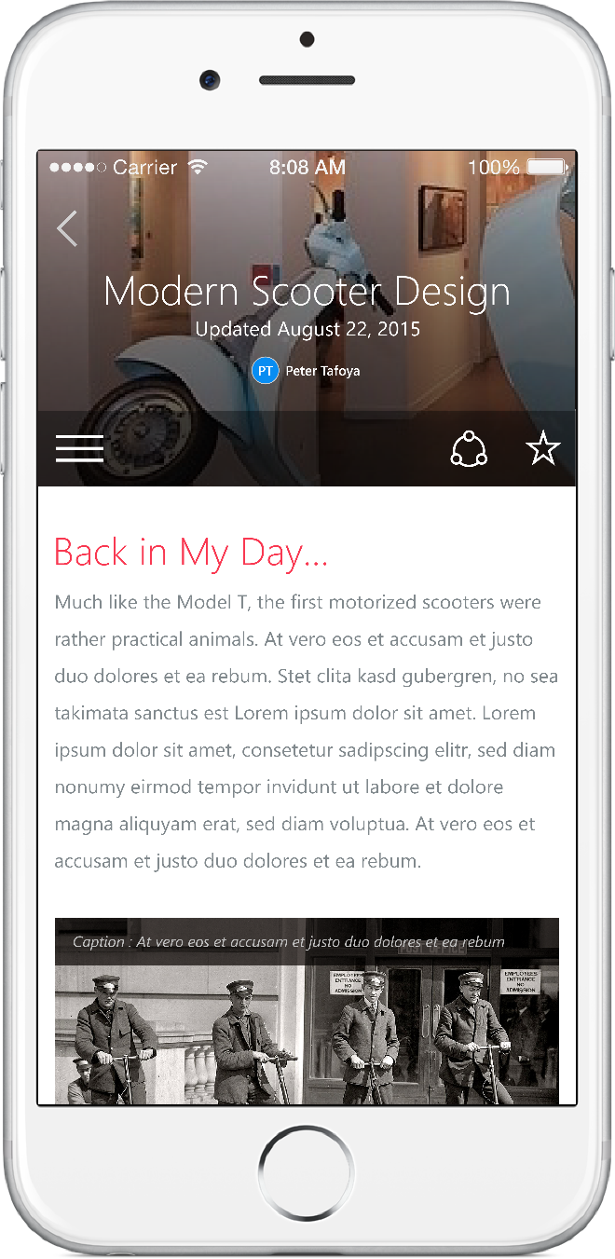
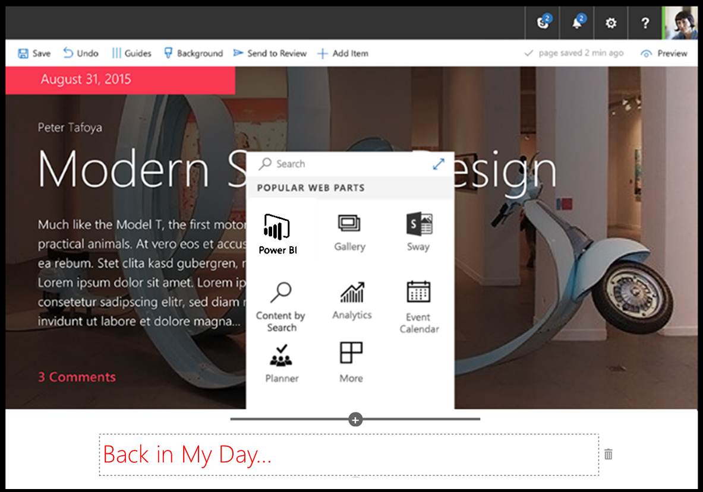
SharePoint Framework
Modern client-side development
Lightweight web and mobile
Powers our own experiences
Backward compatible
Supports open source tools & JavaScript web frameworks
SharePoint Framework
Microsoft Graph
LOB Systems and Cloud Services
Notes:
Built into the SharePoint mobile apps

Slide 10
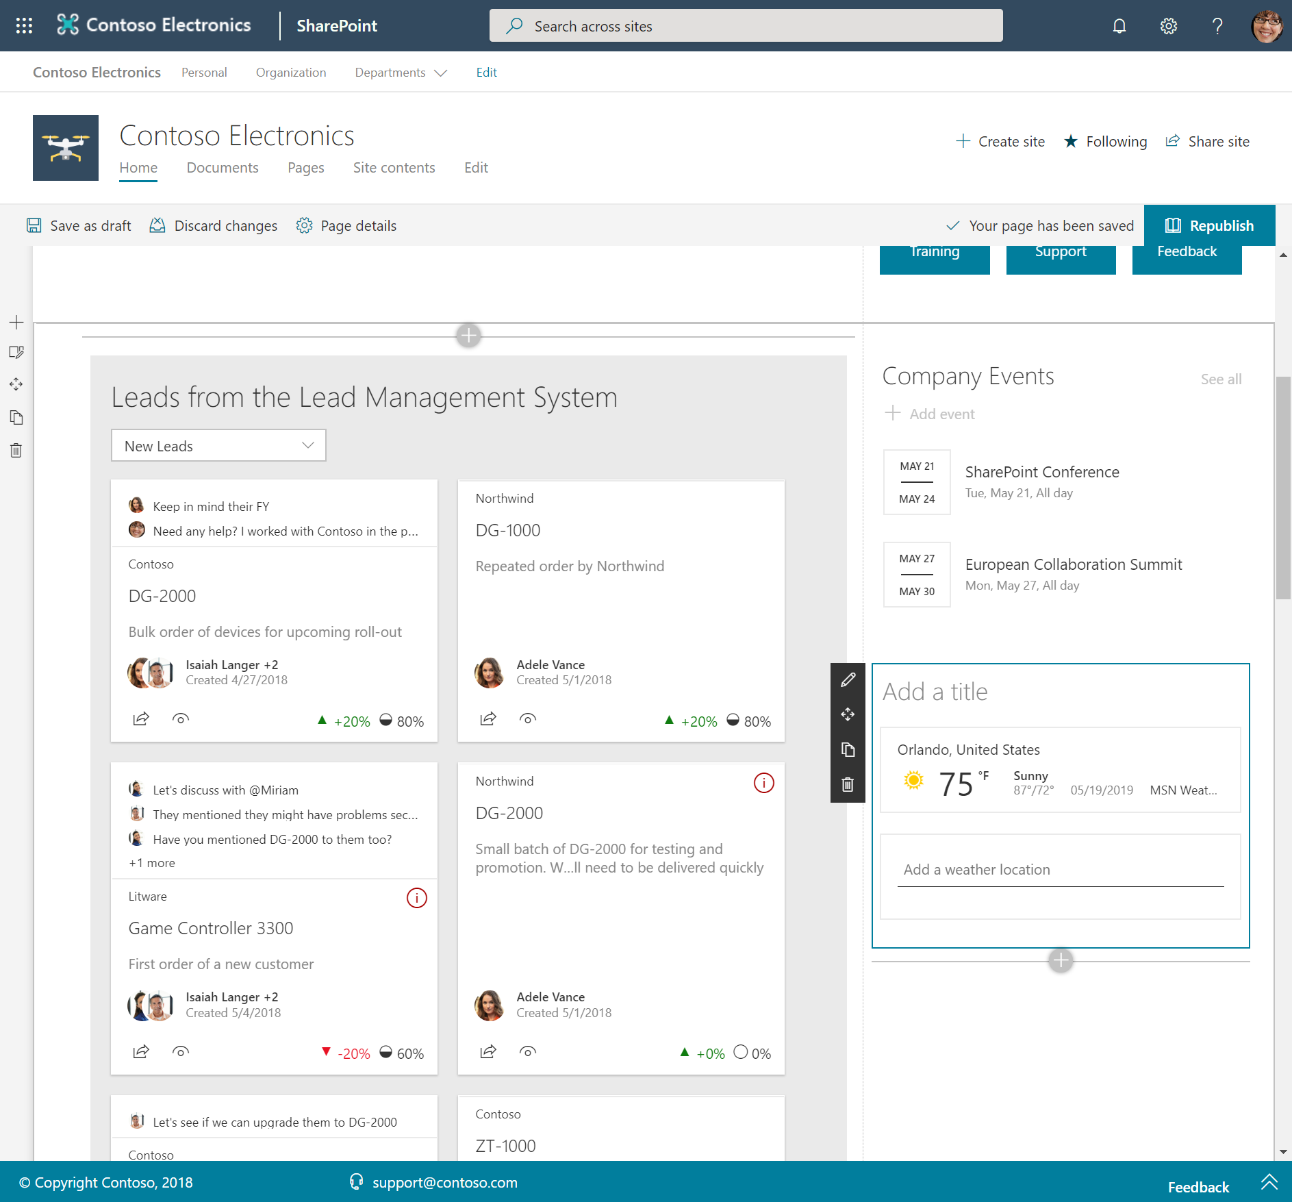
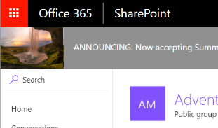
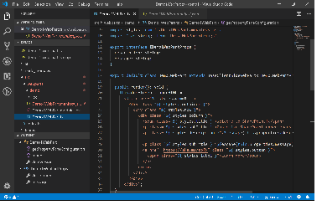
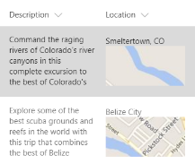
SharePoint Framework component types
Web Parts
Extensions
Libraries

Slide 11
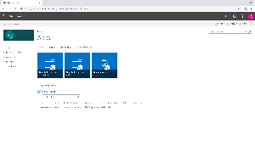
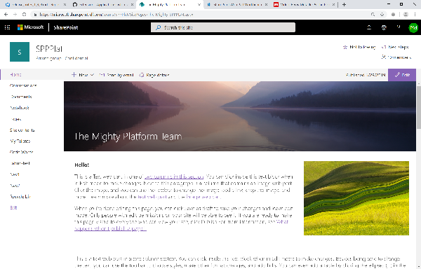
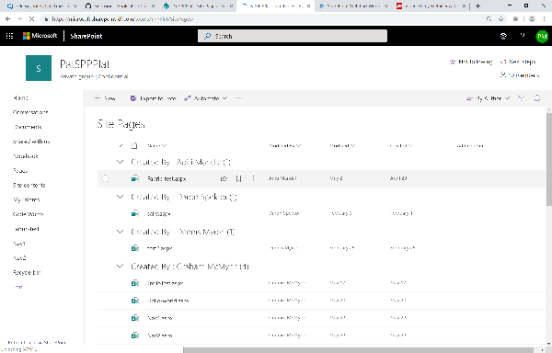
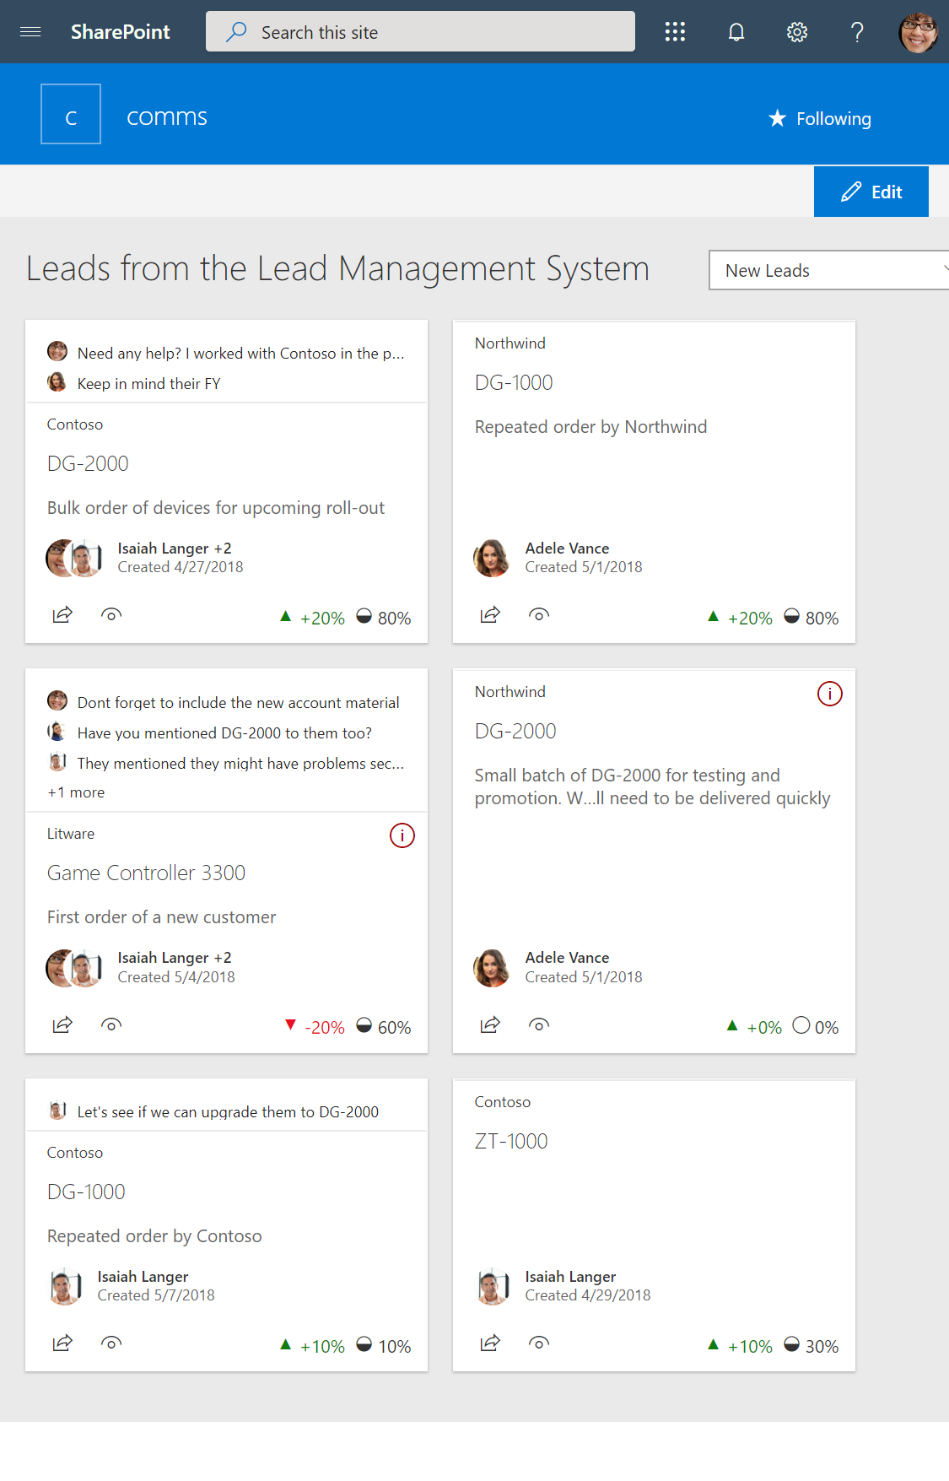
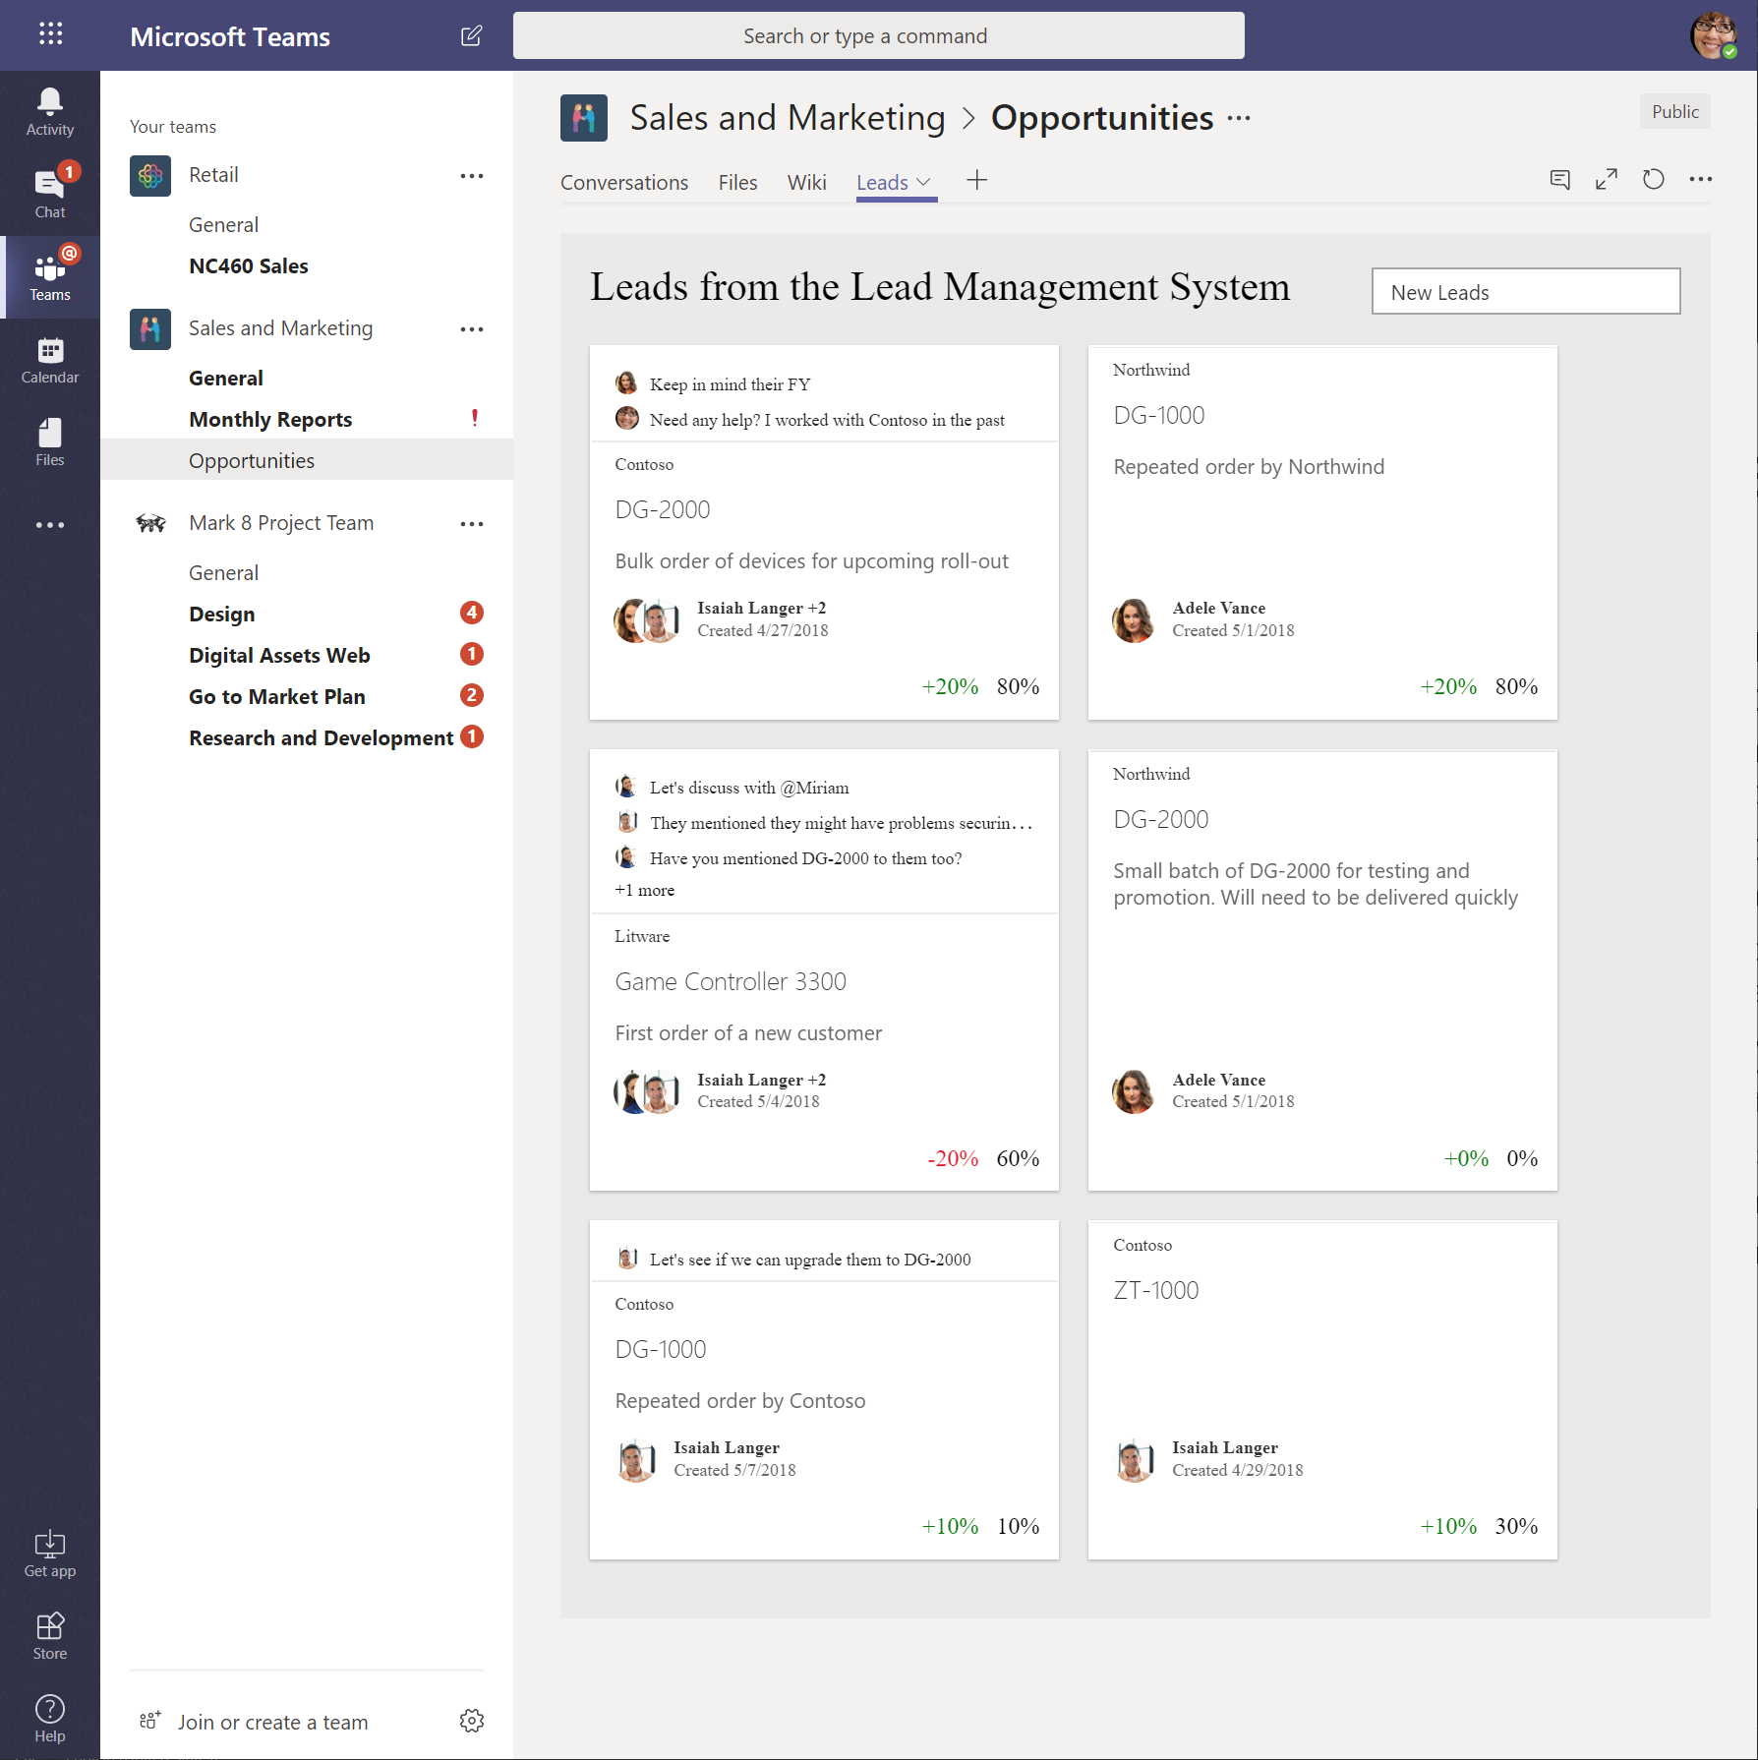
SharePoint Framework Hosted Scenarios
Classic Pages
Modern Pages
Lists and Libraries
App pages
Teams Tabs
Web Parts
Web Parts
Extensions
Web Parts
Web Parts
Extensions
Extensions
Library components work in all hosted platforms

Slide 12

What’s a modern page?
Client-side rendered
Natively responsive
Client-side web parts
Client-side and persisted caches
Mobile optimized
Notes:
Client-side rendered using Open Source web tech
CDN deployed web apps with client side interactivity and fast page routing
Client-side web parts
Client-side and persisted caches
Mobile optimized (responsive)

Slide 13
Modern Site Pages
Easily create powerful, beautiful looking pages
Communicate ideas and information using our new authoring canvas and gallery of web parts.
Modern building blocks
Authoring canvas and web parts are built using client-side HTML and JavaScript. Pages are reusable in custom applications
Mobile support is built in from the start
Content reflows across device sizes and pages are fast and fluid.
Pages get better with the Microsoft Graph
Authors can leverage Microsoft Graph to surface relevant pages to the people that need to read them.

Slide 14
Agenda
Preparing your machine for the SPFx
Setup Office 365
Create AppCatalog
Visual Studio Code
Node.js/NPM – local hosting and module management
Yeoman – project scaffolding
Gulp – task runner

Slide 15
Office 365 Developer Tenant Setup Steps
Sign up for an Office 365 Developer Tenant
Create app catalog site
Create a new site collection for testing – dev or normal
1-2-3
Notes:
To build and deploy client-side web parts using the the SharePoint Framework, you will need an Office 365 Tenant.

Slide 16
Join the Office 365 Developer Program!
Setup Office 365
Go to https://developer.microsoft.com/en-us/office/dev-program
Signup for a free 12-month office 365 developer subscription
Refer below document
Lab 1 - Set up a Microsoft 365 E5 Developer subscription .docx
Notes:
To build and deploy client-side web parts using the the SharePoint Framework, you will need an Office 365 Tenant.

Slide 17
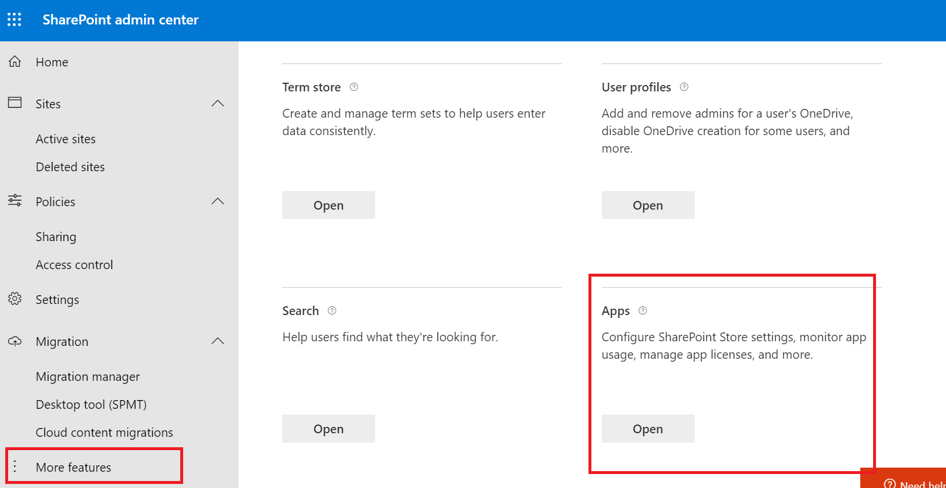
Create App Catalog Site
https://[tenant]-admin.sharepoint.com
SharePoint Framework solutions are deployed to an app catalog when they are ready for distribution

Slide 18
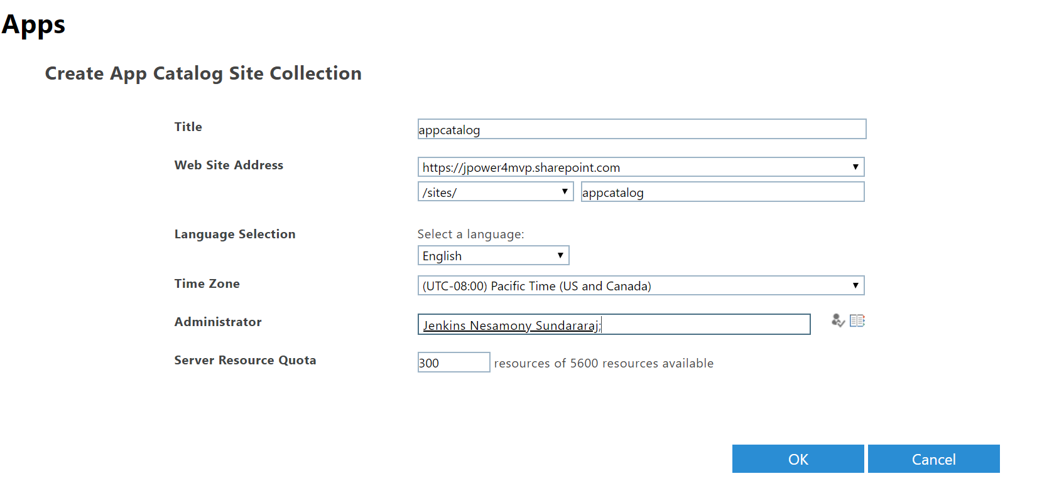
Create App Catalog Site
Refer below document
Lab 2 - Create the App Catalog site collection.docx

Slide 19
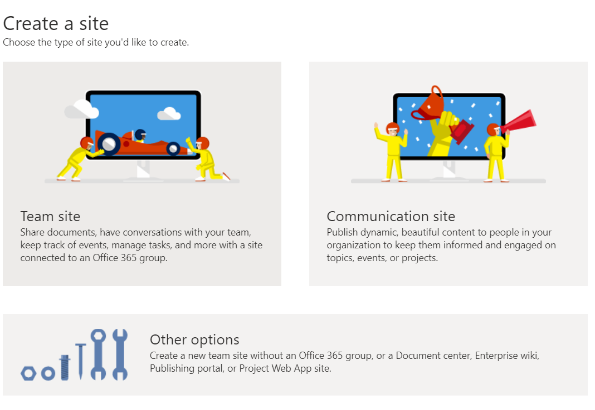
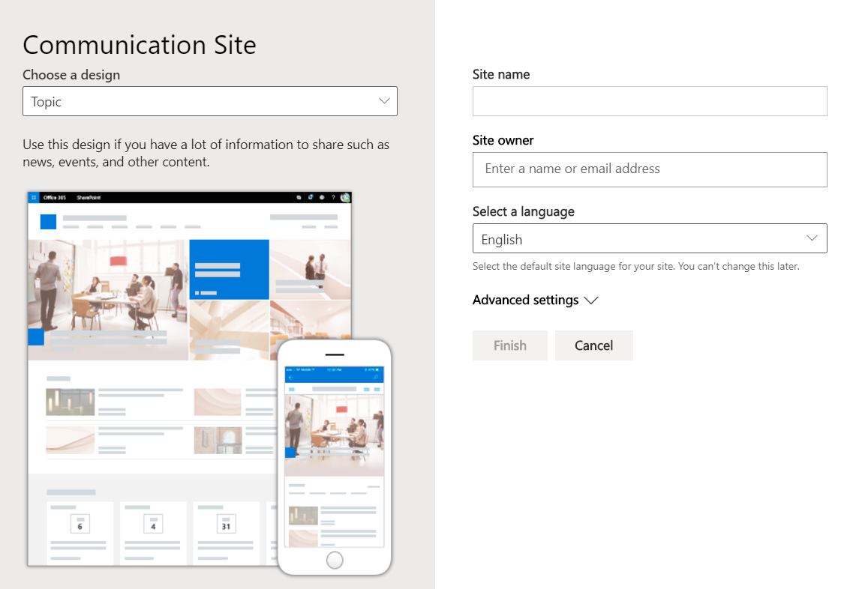
Create a new Development Site collection
https://[tenant]-admin.sharepoint.com
Use this site collection to test web parts and extensions

Slide 20
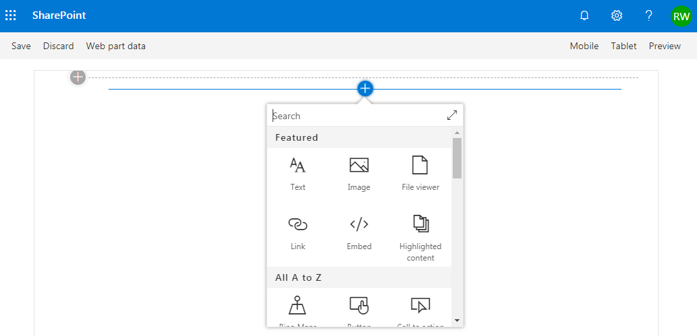
SharePoint Online Hosted Workbench
https://[sharpeointonline-site]/_layouts/15/workbench.aspx
SharePoint Online workbench can be accessed under any site with _layouts URL. Hosted site provides you site context where solution is executed.

Slide 21

Configuring your SPFx Development Environment
Tool Comparison: Server-side vs. client-side
Node.js
NPM, Yeoman, Gulp
TypeScript

Slide 22






Open-source tooling
SharePoint Framework leverages an open source, Node.js based toolchain and embraces all web frameworks + code editors
Build Process & Tooling
Yeoman Templates
Gulp (task runner)
Node.js
NPM (package manager)
SystemJS
Webpack
SASS
TypeScript
Web Frameworks
React
Angular
Knockout
jQuery
… and more… your choice!
Code Editors
Visual Studio Code
Atom
Sublime
Webstorm
… and more… your choice!

Slide 23


Server-side tool comparison
IIS Express
C#
MSBuild
Project Templates

Slide 24
Node.js - Runtime
Cross platform JavaScript runtime
Similar to .NET Framework is a runtime for C# based projects
Used to execute JavaScript on the desktop / server / devices
API wrapper to Chromes V8 JavaScript engine
SPFx’s open-source tooling is built on Node.js
SPFx supports Node.js LTS v12.*
LTS: Long term support
The SharePoint Framework v1.12 is supported on the following Node.js versions:
Node.js v10 (Dubnium)
Node.js v12 (Erbium)
https://nodejs.org/

Slide 25
NPM – Node Package Manager
NPM is a package manager for Node.js based projects
Similar to NuGet that is the .NET Framework package manager
Client tool used to acquire packages from the NPM registry: https://www.npmjs.com
Similar to NuGet that’s the client tool for the NuGet registry: https://www.nuget.org
Included with the default Node.js install
https://www.npmjs.com

Slide 26
Yeoman – Project Scaffolding Generator
Scaffolding engine that executes generators
Generators prompt user with questions
Generates project scaffolding (folders & files) for projects
Microsoft provides SharePoint Framework generator
Installed on your dev environment with NPM
npm install -g yo
npm install -g @microsoft/generator-sharepoint
http://yeoman.io

Slide 27
Gulp – Task Runner
Gulp is a task runner for projects
Similar to MSBuild that is the .NET Framework task runner
Tasks are defined with JavaScript
Similar to MSBuild tasks defined in XML
Performs common tasks: compile, package, start test process, etc.
Microsoft has created all required tasks
npm install -g gulp
http://gulpjs.com

Slide 28
TypeScript – Typed JavaScript
Typed superset of JavaScript
Compiles to plain JavaScript
Development language for the base templates in SharePoint Framework projects
You can also integrate native JavaScript to SharePoint Framework customizations *
No need to rewrite everything
Version of TypeScript supported by SPFx included in each SPFx project
https://www.typescriptlang.org

Slide 29
Validate local SPFx development configuration
Install required runtimes & tools:
Node.js & NPM (included with Node.js)
Yeoman, SPFx Yeoman generator
Gulp
Create first project with Yeoman & SPFx generator
Build & run web part in the local workbench
yo @microsoft/sharepoint
gulp serve

Slide 30
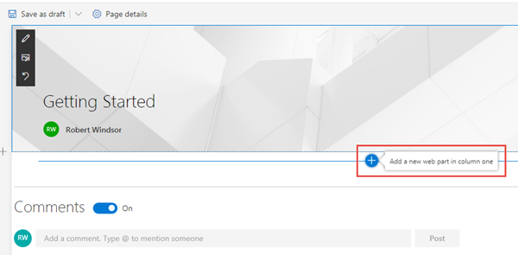
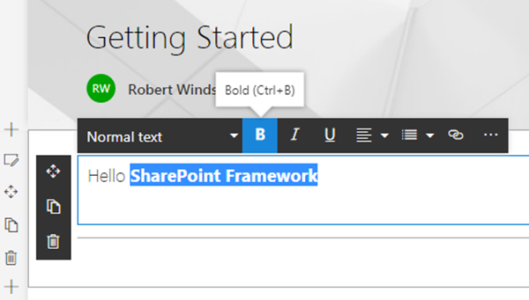
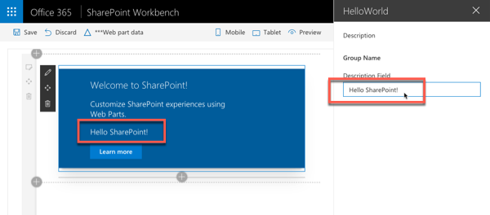
Adding SPFx web parts to pages
Once a page is in edit mode, add via web part toolbox
Select a web part and edit inline or using the property pane

Slide 31
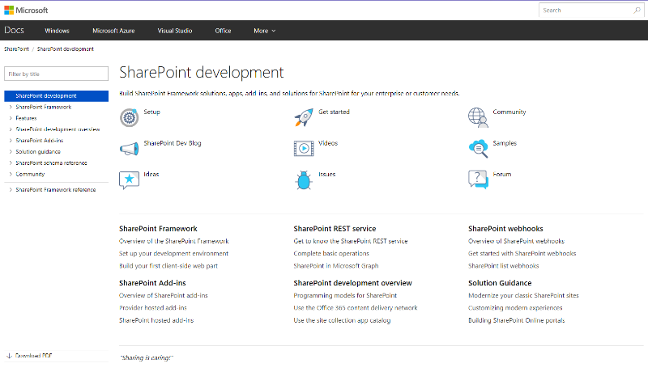
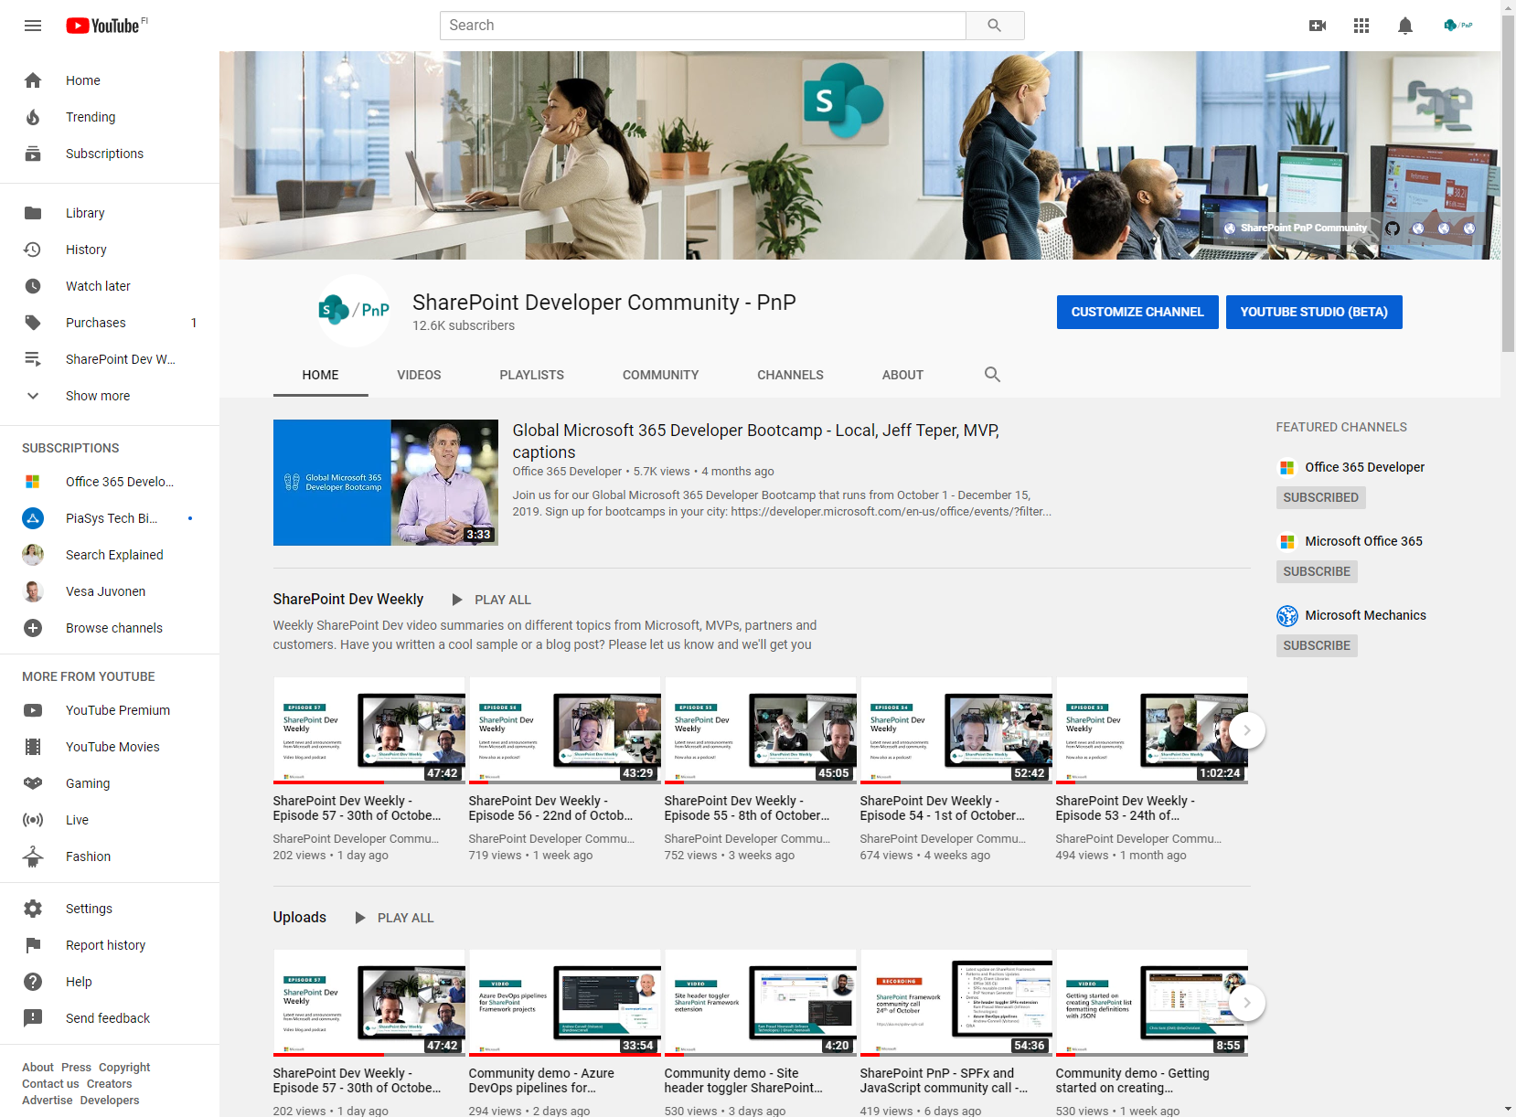
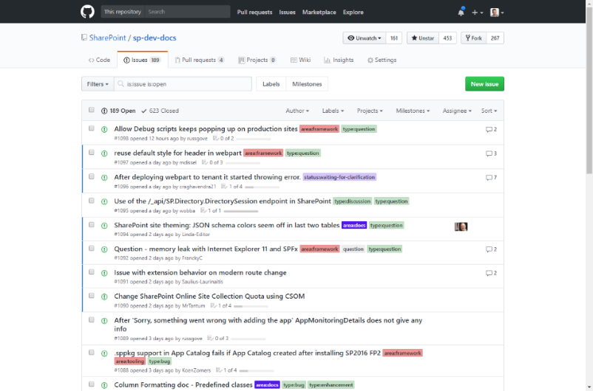
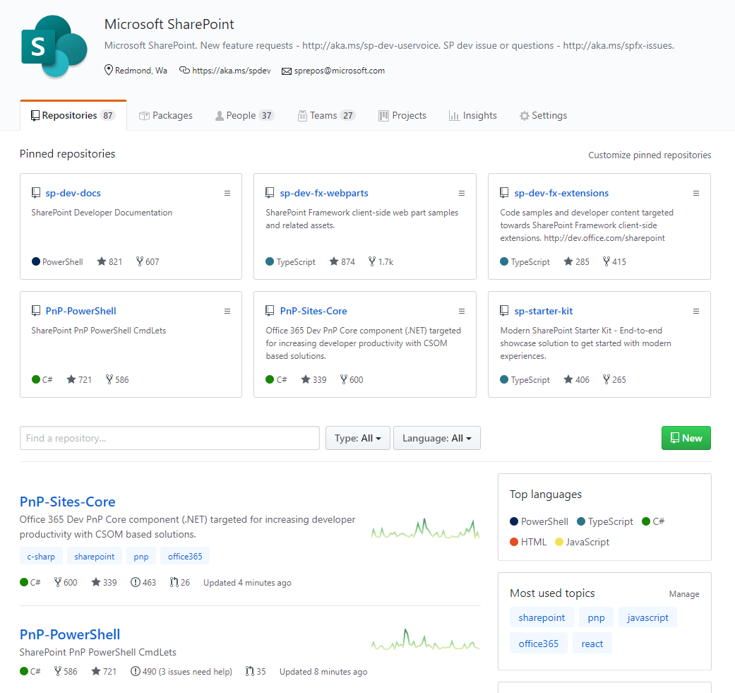
SharePoint Dev docs
SharePoint (Dev) videos
SharePoint Dev issues
Open-source
aka.ms/spdev-docs
aka.ms/spdev-videos
aka.ms/spdev-issues
github.com/sharepoint
github.com/pnp

Slide 32
Demo
Creating & Running Your First SPFx Project

Slide 33
Agenda
TypeScript
What is TypeScript
Using TypeScript in your project
Variables
Functions
Interfaces and Classes
Modules and Namespaces

Slide 34
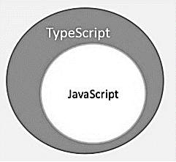
What is TypeScript?
By definition, “TypeScript is JavaScript for application-scale development.”
TypeScript is a strongly typed, object oriented, compiled language. It was designed by Anders Hejlsberg (designer of C#) at Microsoft. TypeScript is both a language and a set of tools. TypeScript is a typed superset of JavaScript compiled to JavaScript. In other words, TypeScript is JavaScript plus some additional features.
TypeScript
JavaScript
var message:string = "Hello World"
console.log(message)
var message = "Hello World";
console.log(message);

Slide 35
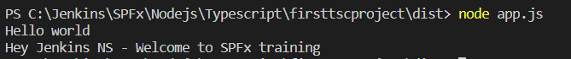
Using TypeScript in your project
Install Typescript - npm install -g typescript
Compile tsc app.ts
Execute node app.js
Typescript configuration tsc --init
"target": "es6“
Compile tsc
"outDir": "./dist“
Execute node app.js

Slide 36
Variables
Variables can be declared using: var, let, and const
var Declaration
Variables in TypeScript can be declared using var keyword, same as in JavaScript. The scoping rules remains the same as in JavaScript.
var string1:string = "string val“
let Declaration
To solve problems with var declarations, ES6 introduced two new types of variable declarations in JavaScript, using the keywords let and const. TypeScript, being a superset of JavaScript, also supports these new types of variable declarations.
Let variables cannot be re-declared
let string2:string = "string val 2s “
const Declaration
Variables can be declared using const similar to var or let declarations. The const makes a variable a constant where its value cannot be changed. Const variables have the same scoping rules as let variables.
const num:number = 100;

Slide 37
Data Types
Data Types | Description | Syntax
Number | TypeScript supports number data type, All numbers are stored as floating-point numbers. These numbers can be Decimal (base 10), Hexadecimal (base 16) or Octal (base 8). | let first:number = 123;
String | String is another primitive data type that is used to store text data. String values are surrounded by single quotation marks or double quotation marks | let employeeName:string = 'John Smith'; let employeeName:string = "John Smith";
Boolean | Boolean values are supported by both JavaScript and TypeScript and stored as true/false values | let isPresent:boolean = true;
Array | An array is a special type of data type which can store multiple values of different data types sequentially using a special syntax. | let fruits: string[] = ['Apple', 'Orange', 'Banana']; let fruits: Array<string> = ['Apple', 'Orange', 'Banana'];
Tuple | TypeScript introduced a new data type called Tuple. There are other data types such as number, string, boolean etc. in TypeScript which only store a value of that particular data type. Tuple is a new data type which includes two set of values of different data types. | var employee: [number, string] = [1, "Steve"];
Enum | Enums or enumerations are a new data type supported in TypeScript. Most object-oriented languages like Java and C# use enums. This is now available in TypeScript too. | enum PrintMedia { Newspaper, Newsletter, Magazine, Book }
Union | TypeScript allows us to use more than one data type for a variable or a function parameter. This is called union type. | let code: (string | number);
Any | TypeScript has type-checking and compile-time checks. However, we do not always have prior knowledge about the type of some variables, especially when there are user-entered values from third party libraries. | let something: any = "Hello World!"; something = 23; something = true;
Void | Similar to languages like Java, void is used where there is no data type. For example, in return type of functions that do not return any value | function sayHi(): void { console.log('Hi!') }
Notes:
Number
let first:number = 123; // number let second: number = 0x37CF; // hexadecimal let third:number=0o377 ; // octal let fourth: number = 0b111001;// binary
String
let employeeName:string = 'John Smith';
Number
let isPresent:boolean = true;
Array
let fruits: string[] = ['Apple', 'Orange', 'Banana']; let fruits: Array<string> = ['Apple', 'Orange', 'Banana']; MultiType Array let values: (string | number)[] = ['Apple', 2, 'Orange', 3, 4, 'Banana']; let values: Array<string | number> = ['Apple', 2, 'Orange', 3, 4, 'Banana'];
Tuple is a new data type which includes two set of values of different data types var employee: [number, string] = [1, "Steve"];
Enum
enum PrintMedia { Newspaper = 1, Newsletter = 5, Magazine = 5, Book = 10 }
Union
let code: (string | number);
Any
let something: any = "Hello World!";
something = 23;
something = true;
Void
function sayHi(): void { console.log('Hi!') }

Slide 38
Functions
Functions are the primary blocks of any program. In JavaScript, functions are the most important part since the JavaScript is a functional programming language. With functions, you can implement/mimic the concepts of object-oriented programming like classes, objects, polymorphism, and, abstraction.
Functions ensure that the program is maintainable and reusable, and organized into readable blocks. While TypeScript provides the concept of classes and modules, functions still are an integral part of the language.
In TypeScript, functions can be of two types: named and anonymous.
function display() {
console.log("Hello TypeScript!");
}
display(); //Output: Hello TypeScript
let Sum = function(x: number, y: number) : number
{
return x + y;
}
Sum(2,3); // returns 5
function Sum(x: number, y: number) : number {
return x + y;
}
Sum(2,3); // returns 5
let greeting = function() {
console.log("Hello TypeScript!");
};
greeting(); //Output: Hello TypeScript!

Slide 39
Interfaces
Interface is a structure that defines the contract in your application. It defines the syntax for classes to follow. Classes that are derived from an interface must follow the structure provided by their interface.
The TypeScript compiler does not convert interface to JavaScript. It uses interface for type checking. This is also known as "duck typing" or "structural subtyping".
interface IEmployee {
empCode: number;
empName: string;
}
interface IEmployee {
empCode: number;
empName: string;
getSalary: (number) => number; // arrow function
getManagerName(number): string;
}

Slide 40
Classes
TypeScript introduced classes to avail the benefit of object-oriented techniques like encapsulation and abstraction. The class in TypeScript is compiled to plain JavaScript functions by the TypeScript compiler to work across platforms and browsers.
A class can include the following:
Constructor
Properties
Methods
class Employee {
empCode: number;
empName: string;
constructor(code: number, name: string) {
this.empName = name;
this.empCode = code;
}
getSalary() : number {
return 10000;
}
}

Slide 41
Modules
The TypeScript code we write is in the global scope by default. If we have multiple files in a project, the variables, functions, etc. written in one file are accessible in all the other files.
Export
A module can be defined in a separate .ts file which can contain functions, variables, interfaces and classes. Use the prefix export with all the definitions you want to include in a module and want to access from other modules.
This example module which contains two variables and a class definition. The age variable and the Employee class are prefixed with the export keyword, whereas companyName variable is not.
Thus, this module which exports the age variable and the Employee class to be used in other modules by importing the Employee module using the import keyword. The companyName variable cannot be accessed outside this Employee module, as it is not exported.
export let age : number = 20;
export class Employee {
empCode: number;
empName: string;
constructor(name: string, code: number) {
this.empName = name;
this.empCode = code;
}
displayEmployee() {
console.log ("Employee Code: " + this.empCode + ", Employee Name: " + this.empName );
}
}
let companyName:string = "XYZ";

Slide 42
Modules
Import
A module can be used in another module using an import statement.
import { export name } from "file path without extension"
Importing a Single export from a Module
import { Employee } from "./Employee";
Importing the Entire Module into a Variable
import * as Emp from "./Employee“
Renaming an Export from a Module
import { Employee as Associate } from "./Employee"

Slide 43
Namespace
The namespace is used for logical grouping of functionalities. A namespace can include interfaces, classes, functions and variables to support a single or a group of related functionalities.
A namespace can be created using the namespace keyword followed by the namespace name. All the interfaces, classes etc. can be defined in the curly brackets { }.
namespace <name>
{
}
namespace StringUtility {
export function ToCapital(str: string): string {
return str.toUpperCase();
}
export function SubString(str: string, from: number, length: number = 0): string {
return str.substr(from, length);
}
}

Slide 44
Demo
Using Typescript in your SPFx Webpart

Slide 45
Agenda
SharePoint Framework Client Web Parts
What is a Client Web Part?
Creating a project
Exploring Project Contents
Running Your Project
Gulp tasks
Web Part Configuration

Slide 46
What is a Client Web Part?
Client-side web parts are client-side components that run in the context of a SharePoint page. Client-side web parts can be deployed to SharePoint environments that support the SharePoint Framework. You can also use modern JavaScript web frameworks, tools, and libraries to build them.
Client-side web parts support:
Building with HTML and JavaScript.
Both SharePoint Online and on-premises environments.

Slide 47
Creating a SPFx Project
To begin with the development, just make sure that you have the latest node,yeoman, gulp and yeoman SharePoint generator are installed in your machine. These are needed to ensure your machine’s suitability for the development of SharePoint framework offered by Microsoft.

Slide 48
Node_modules, Package.json
Any SharePoint Framework (SPFx) solution that does something useful will use external JavaScript libraries – whether bigger frameworks such as React or Angular, or smaller, more focused libraries such as LoDash, moment.js or something else.
SPFx is based on a node.js-based web stack, the best way to integrate such libraries into your solution is usually to add them from npm, the internet-based package manager for JavaScript.
Npm is effectively an equivalent of NuGet in the .NET world. Once you’re set up with npm, a developer simply runs npm install jquery [or whatever] and the source code for the package will be added to your application’s files.
As is normal with node development, the library is added under the “node_modules” subfolder, and it can now be referenced in your code.

Slide 49
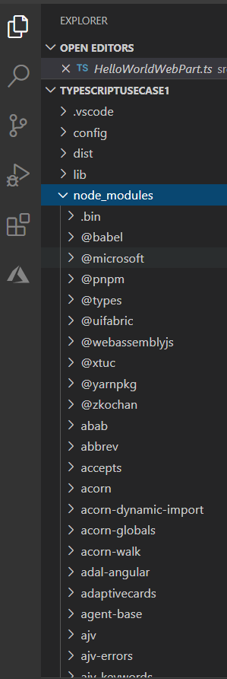
The role of the node_modules folder
The node_modules folder stores all your dependencies. So, it’s a tree structure which can be quite deep. An app which uses jQuery and React for example.

Slide 50
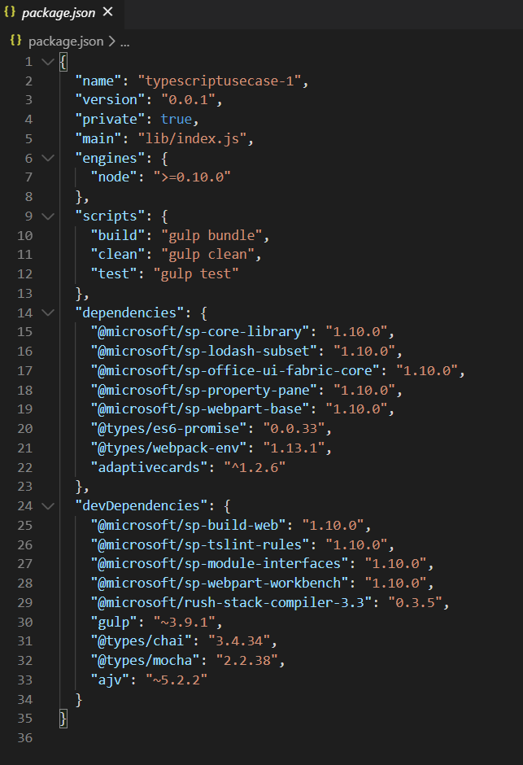
Ensuring dependencies are tracked with package.json
If the --save flag is also specified when adding a package with npm install, an entry is written into the package.json file in the application’s directory. This goes into the “dependencies” section of the file, and will look something like this:

Slide 51
Agenda
Deploying SharePoint Artifacts
Deploying SharePoint Artifacts to app catalog
Deployment Options
Asset Types
Features

Slide 52
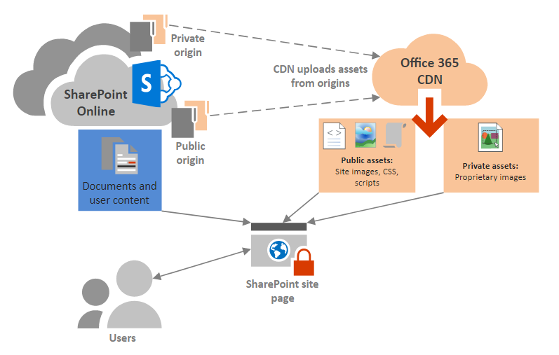
Host your client-side web part
There are multiple different hosting options for your web part assets.
Office 365 / Microsoft 365 CDN
Tenant Level appcatalog
Site Collection Level appcatalog
Azure CDN
SharePoint library CDN

Slide 53
Choose whether each origin should be public or private
When you identify an origin, you specify whether it should be made public or private. Access to CDN assets in public origins is anonymous, and CDN content in private origins is secured by dynamically generated tokens for greater security. Regardless of which option you choose, Microsoft does all the heavy lifting for you when it comes to administration of the CDN itself. Also, you can change your mind later, after you've set up the CDN and identified your origins.
Public origins within the Office 365 CDN are accessible anonymously, and hosted assets can be accessed by anyone who has the URL to the asset. Because access to content in public origins is anonymous, you should only use them to cache non-sensitive generic content such as javascript files, scripts, icons and images.
Private origins within the Office 365 CDN provide private access to user content such as SharePoint Online document libraries, sites and proprietary images. Access to content in private origins is secured by dynamically generated tokens so it can only be accessed by users with permissions to the original document library or storage location. Private origins in the Office 365 CDN can only be used for SharePoint Online content, and you can only access assets in private origins through redirection from your SharePoint Online tenant.

Slide 54
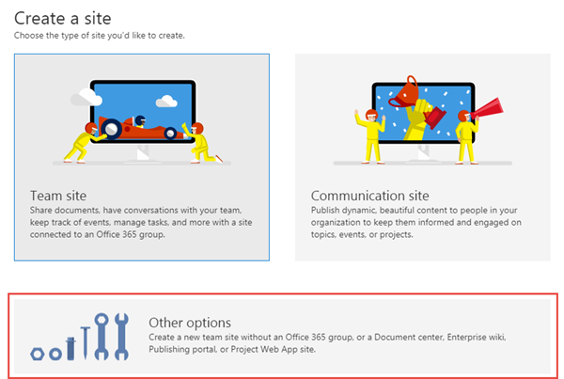
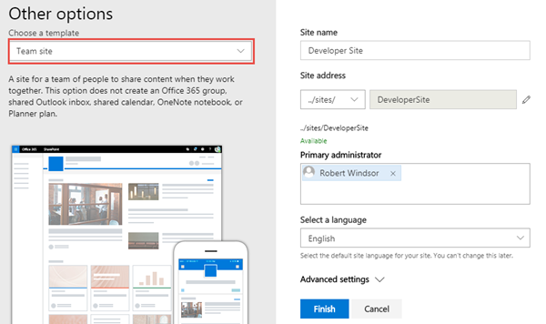
Create a new Development Site collection
https://[tenant]-admin.sharepoint.com
Use this site collection to test web parts and extensions

Slide 55
SharePoint Online Hosted Workbench
https://[sharpeointonline-site]/_layouts/workbench.aspx
SharePoint Online workbench can be accessed under any site with _layouts URL. Hosted site provides you site context where solution is executed.

Slide 56
Microsoft 365 CDN
You can use the built-in Microsoft 365 Content Delivery Network (CDN) to host static assets to provide better performance for your SharePoint Online pages. The Microsoft 365 CDN improves performance by caching static assets closer to the browsers requesting them, which helps to speed up downloads and reduce latency. Also, the Microsoft 365 CDN uses the HTTP/2 protocol for improved compression and HTTP pipelining. The Microsoft 365 CDN service is included as part of your SharePoint Online subscription.
Get the Microsoft 365 CDN status
Connect-SPOService -Url https://contoso-admin.sharepoint.com
Get-SPOTenantCdnEnabled -CdnType Public
Get-SPOTenantCdnOrigins -CdnType Public
Get-SPOTenantCdnPolicies -CdnType Public
https://docs.microsoft.com/en-us/powershell/module/sharepoint-online
https://www.microsoft.com/en-in/download/details.aspx?id=35588

Slide 57
Enable the Microsoft 365 CDN
Once you are connected to your Microsoft 365 tenant, use the following command to enable the Microsoft 365 CDN on your tenant:
Set-SPOTenantCdnEnabled -CdnType Public

Slide 58
Add a new CDN origin
In this case, we are setting the origin as */cdn, which means that any relative folder with the name of cdn acts as a CDN origin.
Add-SPOTenantCdnOrigin -CdnType Public -OriginUrl */cdn

Slide 59
Default CDN origins
Unless you specify otherwise, Office 365 sets up some default origins for you when you enable the Office 365 CDN. If you initially opt not to provision them, you can add these origins after you complete setup. Unless you understand the consequences of skipping the setup of default origins and have a specific reason for doing so, you should allow them to be created when you enable the CDN.
Default private CDN origins:
*/userphoto.aspx
*/siteassets
Default public CDN origins:
*/masterpage
*/style library
*/clientsideassets

Slide 60
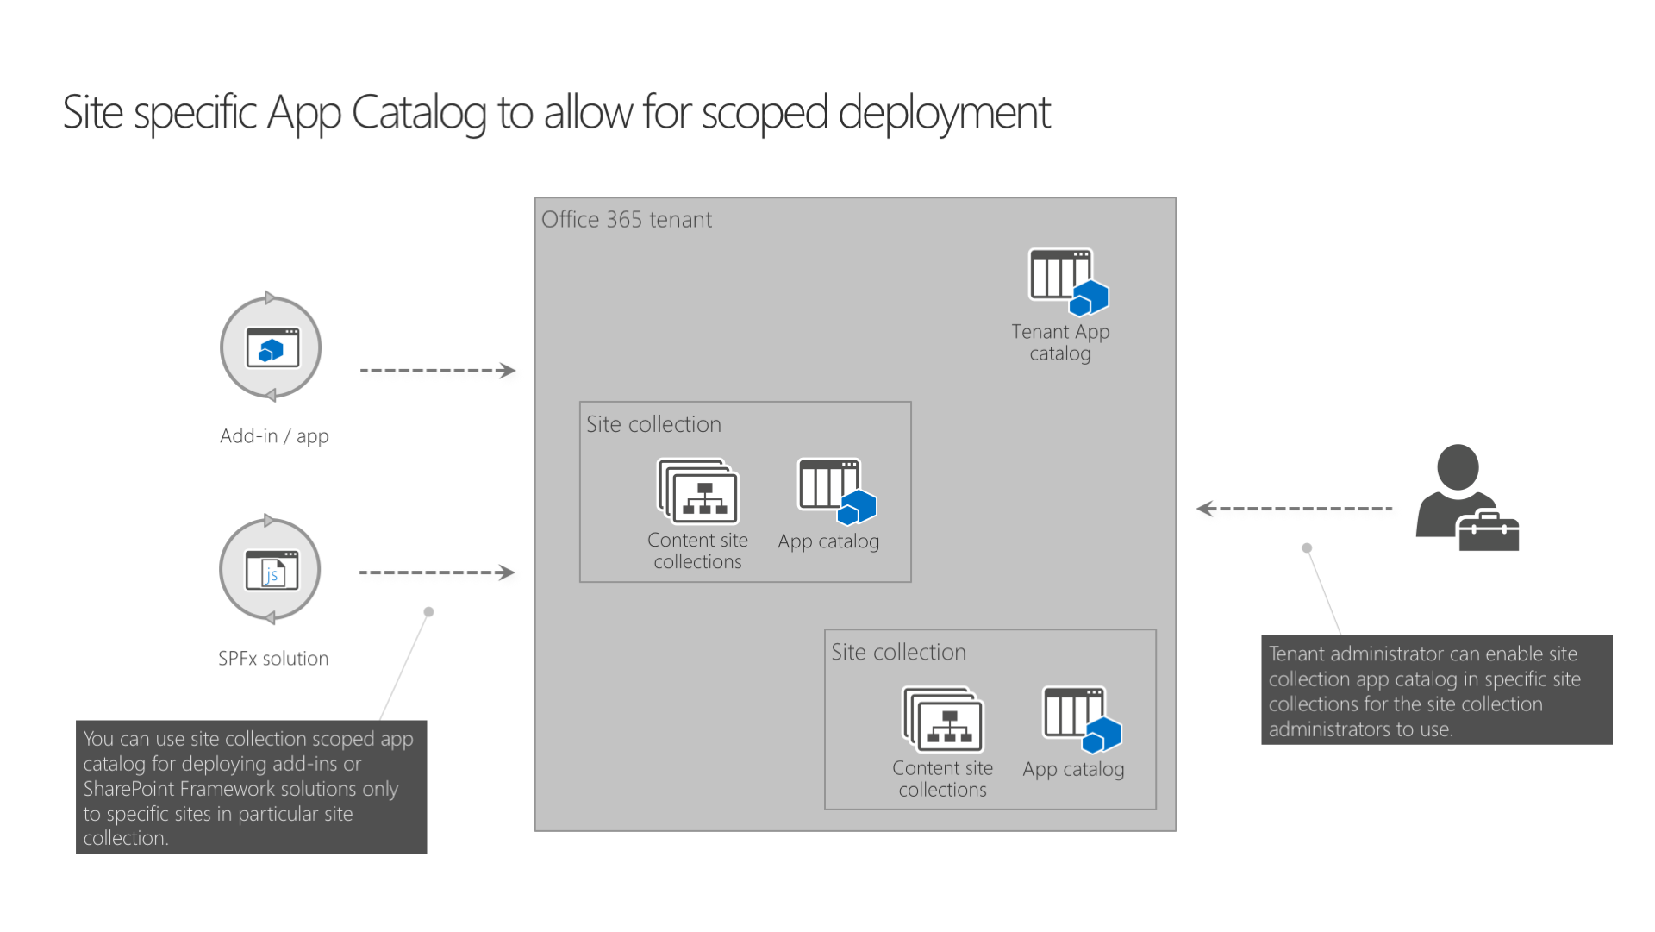
Use the site collection app catalog
Using site collection app catalogs, SharePoint tenant administrators can decentralize the management and scope the deployment of SharePoint add-ins and SharePoint Framework solutions to specific sites.
With the introduction of site collection app catalogs, tenant administrators can enable app catalog on the specific sites. Once enabled, site collection administrators can deploy SharePoint add-ins and SharePoint Framework solutions that will be available only in that particular site collection

Slide 61
Create & Disable a site collection app catalog
Connect-SPOService -Url https://contoso-admin.sharepoint.com
Add-SPOSiteCollectionAppCatalog -Site https://contoso.sharepoint.com/sites/marketing
Remove-SPOSiteCollectionAppCatalog -Site https://contoso.sharepoint.com/sites/marketing
To list all site collections in the tenant that have the site collection app catalog enabled, use the URL https://<tenant-app-catalog-URL>/Lists/SiteCollectionAppCatalogs/AllItems.aspx

Slide 62
Azure CDN
Create a new sample web part and deploy its assets to an Azure Content Delivery Network (CDN) instead of using the default Office 365 CDN as the hosting solution. You'll use an Azure Storage account integrated with a CDN to deploy your assets. SharePoint Framework build tools provide out-of-the-box support for deploying to an Azure Storage account; however, you can also manually upload the files to your favorite CDN provider or to SharePoint.
https://docs.microsoft.com/en-us/sharepoint/dev/spfx/web-parts/get-started/deploy-web-part-to-cdn

Slide 63
Demo
Create a Webpart and Deploy & Host webpart

Slide 64
Agenda
Client Web Part Properties
Client Web Part Properties
Webpart Properties
Adding Properties
Using Properties
Preconfigured Entries

Slide 65
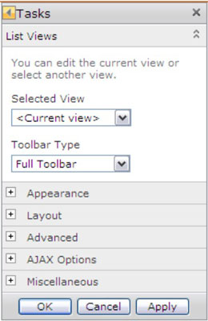
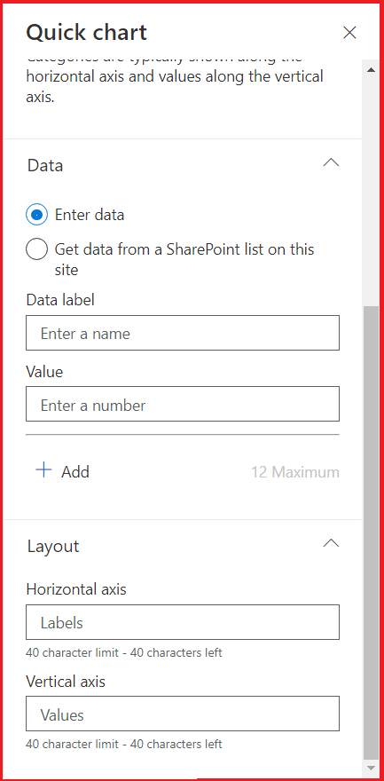
Client Web Part Properties
In classic SharePoint Server web parts can be configured using the properties, generally referred to as WebPart properties. In the SPFx world, they are referred to as property panes. The property panes allow controlling the behavior and appearance of a web part.
The Modern SharePoint Framework have a new WebPart Property pane. The property pane allows end users to configure the web part with a bunch of properties.

Slide 66
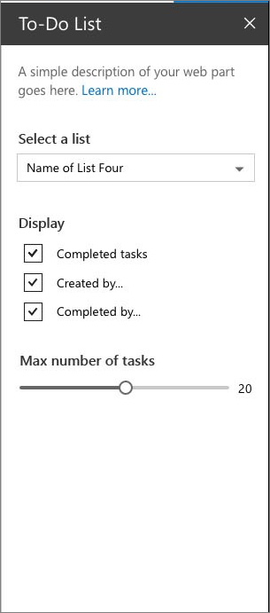
Webpart Properties
The Modern SharePoint Framework have a new WebPart Property pane for WebPart Properties.
The property pane has three key metadata:
Pages
Pages provide you the flexibility to separate complex interactions and put them into one or more pages. Pages then contain Header and Groups.
Header
Header allows you to define the title of the property pane and Groups let you define the various sections for the property pane through which you want to group your field sets.
Groups
A property pane should contain a page, an optional header, and at least one group. Property fields are then defined inside a group

Slide 67
Webpart Properties
Supported Property Fields and Objects
# | Property field | SPFx Typed Object
1 | Label | PropertyPaneLabel
2 | Textbox | PropertyPaneTextField
3 | Multiple lines of text | PropertyPaneTextField
4 | Link | PropertyPaneLink
5 | Dropdown | PropertyPaneDropdown
6 | Checkbox | PropertyPaneCheckbox
7 | Choice | PropertyPaneChoiceGroup
8 | Toggle | PropertyPaneToggle
9 | Slider | PropertyPaneSlider
10 | Button | PropertyPaneButton
11 | Horizontal Rule | PropertyPaneHorizontalRule
12 | Custom | Our own implementation using combination of above
Preconfigured Entries

Slide 68
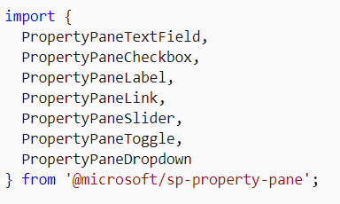
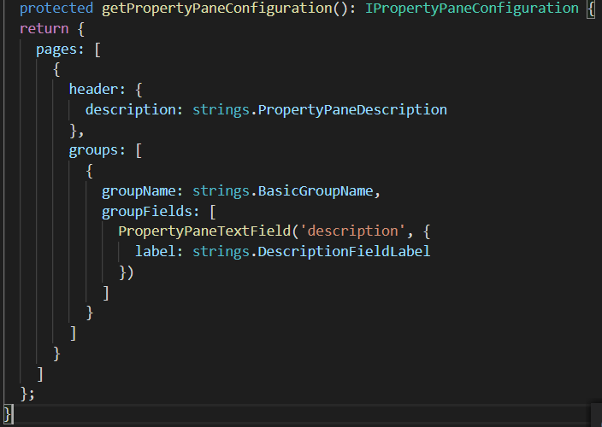
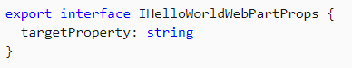
Adding & Using Properties
The field types are available as modules in @microsoft/sp-property-pane. You need to import the objects into a module before you can use them in your web parts.
Note: The property pane objects were split out into their own module, @microsoft/sp-property-pane, in the SharePoint Framework v1.9 release. Prior to this, they were included in the @microsoft/sp-webpart-base module.
Every field type method is defined as follows, taking PropertyPaneTextField as an example →
The targetProperty defines the associated public property on the web part for that field type and is also defined in the props interface in your web part.
To assign types to these properties, define an interface in your web part class that includes one or more target properties.
<p class="${ styles.description }">${escape(this.properties.description)}</p>

Slide 69
Types of property panes
Single pane
Used for simple web parts with a few properties to configure. As the name implies, there is only one single pane without any grouping.
Accordion pane
Contains a group or groups of properties with many options, and where the groups result in a long scrolling list of options.
For example, you might have three groups named Properties, Appearance, and Layout, each with many options.
To make the groups appear as accordions, add a displayGroupsAsAccordion property and set it to true
displayGroupsAsAccordion: true,
If you wish to make the groups initially appear as expanded or collapsed, you can specify the isCollapsed property at the group level and set it to true or false, as desired:
isCollapsed: true,
Steps pane
Group properties in multiple steps or pages. Used when web configuration needs to follow a precise order of steps, or when choices in the first step affect the options that display in next steps.
The property pane will display a Back and Next buttons at the bottom of the pane, along with an indication of how many steps there are, and which step is currently displayed.
By default, the web part will start the property pane on the first page. If you'd like to override this (for example, if you want to bring attention to a specific page to encourage a user to solve an issue), specify the currentPage
currentPage: 3,

Slide 70
Demo
Create a Web Part with all Properties

Slide 71
References
Overview of the SharePoint Framework
https://docs.microsoft.com/sharepoint/dev/spfx/sharepoint-framework-overview
Overview of SharePoint Framework Extensions
https://docs.microsoft.com/sharepoint/dev/spfx/extensions/overview-extensions
Use Page Placeholders from Application Customizer
https://docs.microsoft.com/sharepoint/dev/spfx/extensions/get-started/using-page-placeholder-with-extensions
Tenant Wide Deployment of SharePoint Framework Extensions
https://docs.microsoft.com/sharepoint/dev/spfx/extensions/basics/tenant-wide-deployment-extensions
Build your First Field Customizer Extension
https://docs.microsoft.com/sharepoint/dev/spfx/extensions/get-started/building-simple-field-customizer
Build your First ListView Command Set extension
https://docs.microsoft.com/en-us/sharepoint/dev/spfx/extensions/get-started/building-simple-cmdset-with-dialog-api

Slide 72



SPFx Info
https://docs.microsoft.com/en-us/sharepoint/dev/spfx/sharepoint-framework-overview
Twitter
@ m365pnp
Tech Community
aka.ms/sppnp-community

